Slide 1
Safety Coordinator Webinar
January 2011

Slide 2
Introduction
Introductions
Workplace Postings – posters mailed Jan. 6
Safety Notes – do you want binders/tabs for printed Safety Notes?
Emergency Action Fire Prevention Plan - status

Slide 3
Emergency Eyewash/Showers
According to e-medicalhealth, chemical burns represent 7-10% of eye injuries.
About 15-20% of burns to the face involve at least one eye.
Although many burns result in only minor discomfort, every chemical exposure or burn to the face and body must be taken seriously.
The severity of a burn depends on the substance, how long the substance had contact with the eyes or body, and the treatment.
Permanent damage is possible to both the eyes and body and can be life altering.

Slide 4
Emergency Eyewash/Showers
There are two regulations ANR must comply with in regard of emergency eyewash and showers.
CCR/8-5162 (Cal/OSHA)
CCR/3-6734 (Dept. of Pesticide Regulation)
CCR/8- 5162 requires emergency eyewash/shower equipment to be available in work areas where, during routine operations, the eyes and body may come in contact with a substance which is corrosive or severely irritating to the skin or which is toxic by skin absorption.

Slide 5
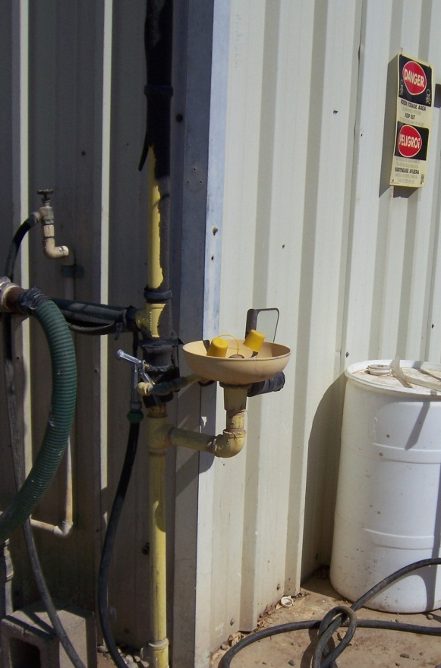
Emergency Eyewash/Showers
ANR work areas typically needing an eyewash/shower are:
Chemical storage areas
Pesticide storage areas
Chemical laboratories
Battery charging areas
Automotive shops

Slide 6
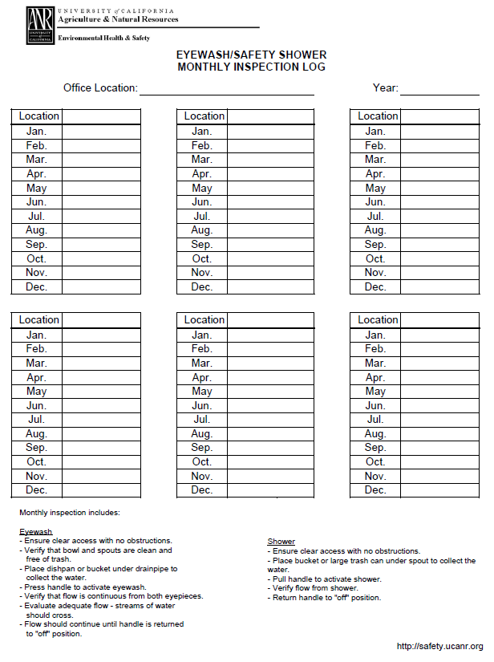
Emergency Eyewash/Showers
CCR/8-5162 requires the eyewash/shower unit to be accessible in locations that require no more than 10 seconds for the injured person to reach.
The area of the eyewash/shower shall be maintained free of items which obstruct their use.
The eyewash/shower must meet the flow rates of 0.4 Gal/Min and for 15 minutes as specified in ANSI Z358.1
Plumbed eyewash/shower units must be inspected by activating them at least monthly to flush the line and to verify proper operation.
Documentation of monthly inspections must also be conducted.

Slide 7
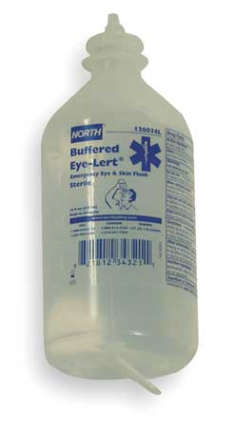
Emergency Eyewash/Showers
CCR/3-6734 states the requirements for pesticide handlers and applicators.
The employer must assure that there is sufficient water, soap and single use towels for routine washing and for emergency eye flushing and washing of the entire body.
The decontamination site must be at the mixing/loading site and not more than ¼ mile (or at the nearest point of vehicular access) from other handlers.
One pint of water for emergency eye flushing must be immediately available (carried by the handler) to each handler.

Slide 8
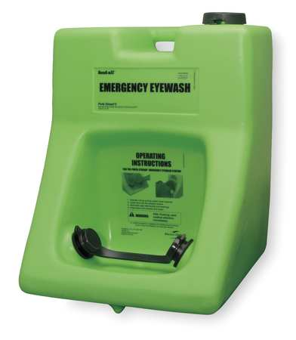
Emergency Eyewash/Showers
During to an inspection by the local Ag. Commissioner at an ANR facility, the inspector required one pint eyewash flush bottles with every pesticide handler regardless if an ANSI rated eyewash was also available. The Department of Pesticide Regulation (DPR) which uses Title 3, only requires the one pint flush bottles to be available at the work area.
Cal-OSHA uses Title 8 for all non-pesticide handling operations and requires ANSI rated eyewash and shower equipment.
ANR EH&S strongly recommends having a permanent or portable eyewash station available for pesticide work in addition to the required pint bottles
BSAS funding is appropriate for the purchasing of portable eyewash that can be used in the field

Slide 9
Online Training
ANR EH&S Orientation Training Update
EH&S orientation training document is currently being reviewed.
EH&S orientation document is scheduled for review by the ANR Training Coordination Advisory Committee.

Slide 10
Online Training
Accessing UC Davis EH&S online training coursework.
Summarizing UC Davis EH&S online training coursework and posting on ANR EH&S web site.
Link summaries to UC Davis EH&S online training.
Course Description | Duration
Machine Guarding Provides machine guarding program definitions, general requirements, and requirements for different types of machinery. Gives a general discussion of various guarding methods, as well as defining terms associated with machine guarding. Describes where mechanical hazards exist, motions and actions of mechanical hazards created by different types of motions, minimum requirements that must be met by all safeguards, advantages and disadvantages of guard construction, and different kinds of safeguard devices and guards. | 30 minutes
Ladder Safety Provides information about the safe use of portable and fixed ladders. Describes the types of portable ladders and their use, safety considerations, specific use, capacities, and safety features of fixed ladders, hazards involved with the use of ladders and control methods that will greatly reduce these hazards, and ladder care and maintenance. | 1 hour

Slide 11
Online Training
Creating EH&S online training modules for specific ANR topics:
Example for IIPP training. (Online PPT)
Example for building evacuation training. (Online e-course)
Would you like EH&S to develop short online training modules for specific ANR topics such as those addressed by Safety Notes? If so, choose five topics from the provided list.

Slide 12
Respiratory Protection
Its that time of year again
A medical evaluation is required the first time an employee is fit tested, if they have had a change in medical condition, or if requested by EH&S.
Next three fit test will be at
KREC on 02/15/11
LREC on 02/16/11
WSREC on 02/17/11
More dates are on our website.
This is open to all REC and CE employees

Slide 13
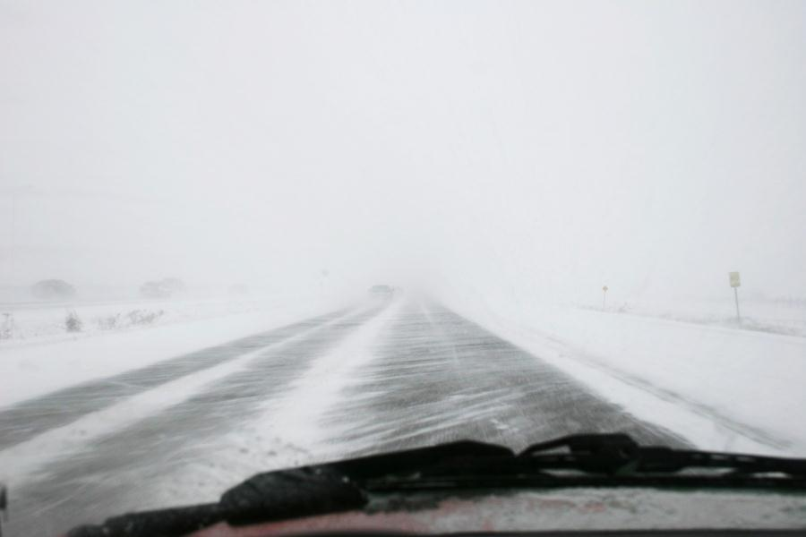
Driver Safety
Winter Driver Safety Tips
Rule number one when driving in hazardous conditions:
SLOW DOWN
In fog or snow turn your lights on, do not use High Beams.
Know your route ahead of time, don’t rely on your GPS it may be out of date!
Remove as many distraction as possible.
Use wipers and defroster as needed to keep your vision clear.
CC Image courtesy of Martin Cathrae on Flickr

Slide 14
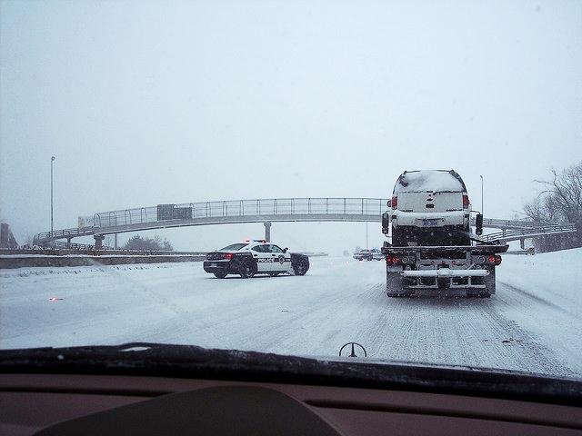
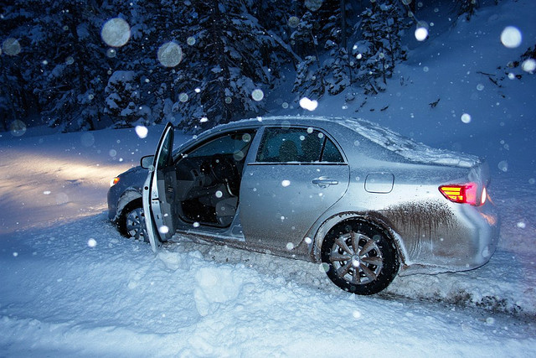
Driver Safety
Additional Winter Driver Safety Tips
Keep a light touch on the controls
Know how to recover from a skid
Watch for hydroplaning conditions
If turning off the road in fog turn all your lights out
See our Safety Note #75 Safe Driving Practices or our online driver safety course for more information.
CC Image courtesy of crazytales562 on Flickr
CC Image courtesy of Alex E. Proimos on Flickr

Slide 15
UC Ready
UC Ready: A Continuity Planning Tool
Readiness to continue our core mission despite disruptive events is the aim of continuity planning
The UC Ready planning tool provides users with a framework for creating a continuity plan; and guides them with simple prompts to identify critical functions, key personnel, planning strategies, vulnerabilities, actions items, etc.
For more information, and a refresher on UC Ready, visit our website at: ucanr.org/ucready

Slide 16
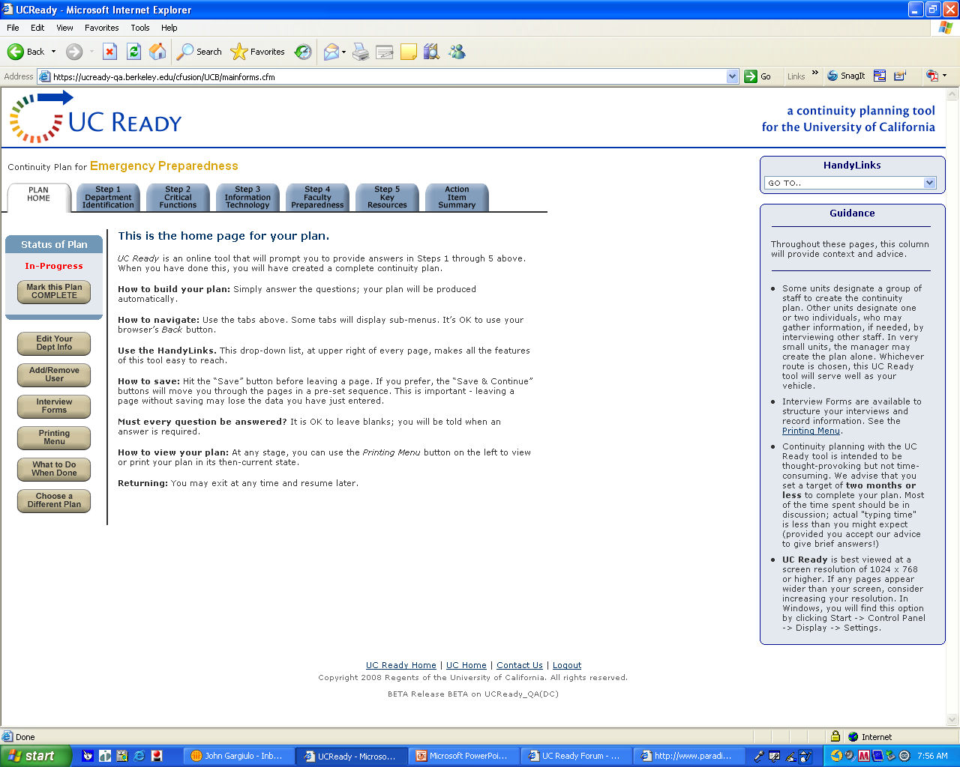

Slide 17
UC Ready
UC Ready: A Continuity Planning Tool
ANR Implementation Timeline (Phase I):
Research & Extension Centers – Mid 2010—Current
As UC maintains operational control of the RECs, they represent the majority of ANR’s ‘risk’
Visits to the RECs, meeting with key staff
Gathered data to create the plan framework
Completion in early 2011

Slide 18
UC Ready
UC Ready: A Continuity Planning Tool
ANR Implementation Timeline (Phase II):
Tier I – ANR Oakland, Admin & Support Units: February—May 2011
Tier II – REC Admin, Statewide Programs: May—Summer 2011
Tier III – County Cooperative Extension Offices (UCCE): Summer 2011—?
Prioritize CE locations
Counties with existing plans (developed for County Gov’t)
Existing emergency preparedness/continuity plans from Counties will be incorporated
Multi-County Partnerships (if/when identified)
We will contact County Directors to provide information about this process
Notes:
Tier I – ANR Oakland, Admin & Support Units – February–May 2011
ANR Oakland (Budget, Financial Services, Development Services, Controller/Business Services); Business Operations Center (BOC); Program Support Unit (PSU); Communication Services/IT; Staff Personnel Unit (SPU); Academic Personnel Unit (APU); Contracts and Grants; EH&S/Risk Services
Tier II – REC Admin, Statewide Programs (4-H, IPM, etc.) – May-Summer 2011

Slide 19
UC Ready
UC Ready: A Continuity Planning Tool
Survey Questions for UCCEs

Slide 20
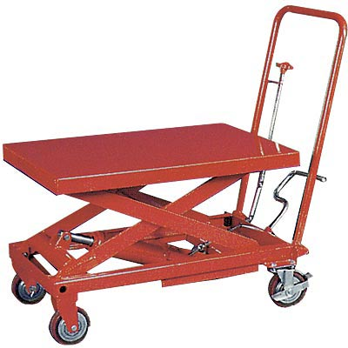
Be Smart About Safety
Recap of 2010 Program
57 locations received funds, over $100k approved
Summary of projects
Types of projects approved
Other projects by EH&S
Requests not approved

Slide 21
Be Smart About Safety
Approved ANR Be Smart About Safety Projects 2009/10
Bench Grinder and Safety Guards (3 locations) |  | Poly Tank - 35 Gallon
Brackets – Adjustable shelves |  | Portable Hand Trucks/Carts/Dollies (12 locations)
Cleaning Equip: Vacuum, Mop, Broom (4 locations) |  | Power Converter for field radio
Emergency Communication: Radios, Sirens (11 locations) |  | Refrigerators for Samples/Specimens (2 locations)
Emergency Supplies for Office, Field, Vehicles (4 locations) |  | Safety Equip: Kneepads, Helmets, Face Shields, Goggles (11 locations)
Ergonomics (29 locations) (chairs, keyboard, mouse, tray, headset, etc.) |  | Safety Tools: Pruning, Cutting, Flagging, Wrench (2 locations)
Extension Cords/Wiring Upgrade/Themostat/Switch (10 locations) |  | Safety Signs and Postings (5 locations)
Eyewash Equipment (6 locations) |  | Satellite Emergency Tracker
Field Wagon |  | Security Gate
Fire Extinguishers: Office and Vehicles (2 locations) |  | Self Defense Training
First Aid Kits for Office and Field (11 locations) |  | Specialized Equipment for Hazards (snakes, snow shovels) (2 locations)
Flashlights/Lanterns, Fixed/Tail/Emergency Lights (10 locations) |  | Spill kit / Absorbent / Containment Trays (2 locations)

Slide 22
Be Smart About Safety
Approved ANR Be Smart About Safety Projects 2009/10
Flatbed Ramps |  | Step Stools or Ladders (8 locations)
Folder for Newspapers, etc. |  | Shelving/Cabinets for Safe Storage of Tools, Chemicals, etc. (7 locations)
Hand Sanitizer Products (3 locations) |  | Storage Rack
Heat Illness Prevention (water coolers, umbrellas) (8 locations) |  | Training: CPR/AED/First Aid (9 locations)
High Lift Jack, Lift Positioner, Drum Lift (4 locations) |  | Training: Food Safety
Hog Panels |  | Truck and Trailer Safety Equipment
Non-Slip Mats/Work Surface (6 locations) |  | Ventilation: Fans, Window, Fume Hood (4 locations)
Paper Shredder |  | Vehicles: Traffic Cones, Load Straps, Jumper Cables, Wheel Chock (7 locations)
Oil Pump for Shop |  | Water Pump
 |  | Water Safety Equipment
Projects Managed by EH&S for Multiple ANR Sites |  | Requests Not Approved
Driver Safety Training |  | Ceiling Mount Projector for Conference Room
EH&S Specialist |  | Client Office Chair
H1N1 Kits |  | Electrolyte Drink Mix for Water Coolers
Lock Out/Tag Out Kits |  | New Building Egress
Safety Coordinator Program and Meetings |  | Portable Defibrillator for Field/Camp Use
Safety Signs, Brochures, and Promotion Items |  | Portable GPS Navigation Units for UC Vehicles
Spanish Tranlations of Documents |  | Replace Single Pane with Tempered Pane Windows
Stop Saws |  | Speed bumps for entrance road
Training Videos |  | Water Cooler & Water Bottles for Office

Slide 23
Be Smart About Safety
Call for 2011 Projects
Application process same as prior years
Submit applications by March 31
Contact Brian to discuss project ideas
Consider injury history when planning BSAS projects
Injury Data (2007-2010)
Incident Type | %
Struck an Object | 28%
Slip/Trip/Fall | 15%
Reaching/Over Extension | 11%
Lifting | 10%
Vehicle Accident | 6%
Nature of Injury | %
Strain or Sprain | 38%
Laceration(s) | 12%
Contusion/Bruise | 8%
Pain – Chronic | 7%
Exposure to Chemical | 5%

Slide 24
Conclusion
Questions?
How can we help you?
Topics for future webinars?

